Slide 1

Decision Making

Slide 2
Decision Making In Java
Sometimes our program needs to take a decision based on whether a particular condition has occurred or not. Then our program will execute certain statements based on this decision.
Decision making in Java can be achieved using any of the following statements.
1. If statement 2. switch statement 3. conditional operator statement

Slide 3
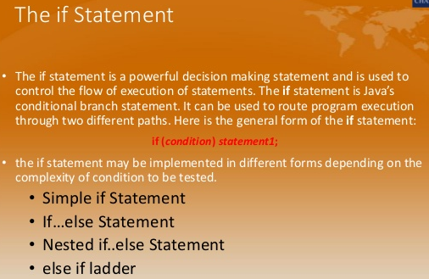

Slide 4
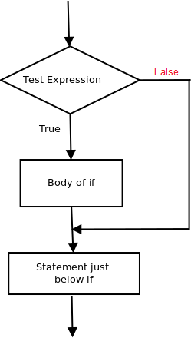
if statement
1. Simple if statement
If(condition) { Statements which will be executed if the condition is true } Statements that need to be executed always
Here if the condition is true, the code which is written inside the curly brackets {} of the if block will be executed, otherwise it will be skipped.

Slide 5
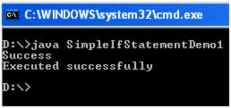
Example
/* * FileName : SimpleIfStatementDemo1.java */ public class SimpleIfStatementDemo1 { public static void main(String args[]) { //Declaring a variable "test" and initializing it with a value 10 int test=10; //Checking if "test" is greater than 5 if(test>5) { //This block will be executed only if "test" is greater than 5 System.out.println("Success"); } //The if block ends. System.out.println("Executed successfully"); } }

Slide 6
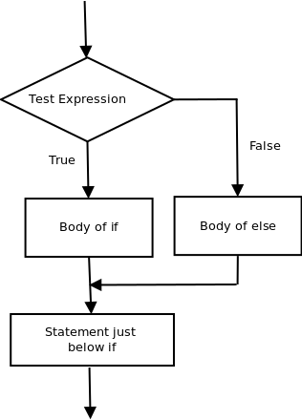
2. if else statement
Syntax
If(condition) { Statements which will be executed if the condition is true } else { Statements which will be executed if the condition is false }
Statements that need to be executed always
Here if the condition is true, the code which is written inside the curly brackets {} of the if block will be executed. If the condition is false, the code which is written inside the curly brackets {} of the else block will be executed.

Slide 7
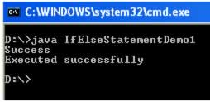
}
else
{
//This block will be executed only if "test" is not greater than 5
System.out.println("Failure");
}
//The if else blocks ends.
System.out.println("Executed successfully");
}
}
Example
public class IfElseStatementDemo1
{
public static void main(String args[])
{
//Declaring a variable "test" and initializing it with a value 10
int test=10;
//Checking if "test" is greater than 5
if(test>5)
{
//This block will be executed only if "test" is greater than 5
System.out.println("Success");

Slide 8
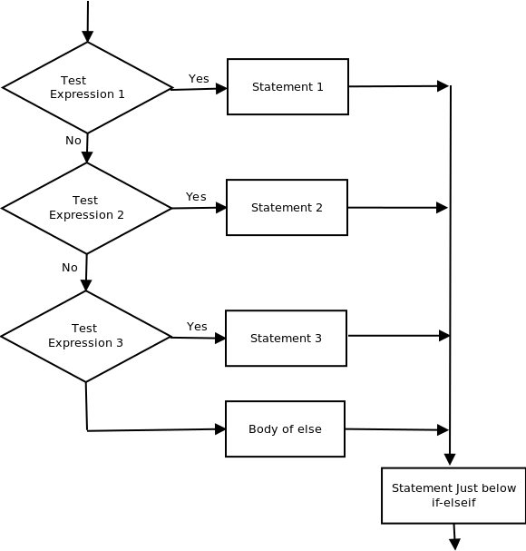
3. if–else-if ladder
Syntax
If(condition-1) { StatementsStatements which will be executed if condition-1 is true } else if (condition-2) { StatementsStatements which will be executed if condition-2 is true } …. else if (condition-n) { StatementsStatements which will be executed if condition-n is true } else { StatementsStatements which will be executed if none of the conditions in condition-1, condition2,…condition-n are true. }

Slide 9

Example program
else if(test==2)
{
//This block will be executed only if "test" is equal to 2
System.out.println("Hi");
}
else if(test==3)
{
//This block will be executed only if "test" is equal to 3
System.out.println("Good");
}
else
{
System.out.println("No Match Found");
}
}
}
public class IfElseIfLadderDemo1
{
public static void main(String args[])
{
//Declaring a variable "test" and initializing it with a value 2
int test=2;
if(test==1)
{
//This block will be executed only if "test" is equal to 1
System.out.println("Hello");
}

Slide 10
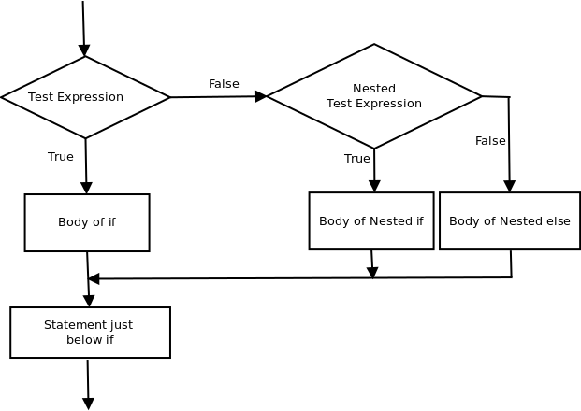
4. Nested if…else statement
You can combine multiple if / if-else /if-else-if ladders when a series of decisions are involved. So you can make sure that your program executes certain instructions when a series of conditions are met.
Example
The following program outputs the message
1. “Hi, test1 is 5 and test2 is 3” if test1 is equal to 5 and test2 is equal to 3
2. “Hi, test1 is 5 and test2 is some value other than 3” if test1 is equal to 5 and test2 is some value other than 3
3. “Hi, test1 is 4” if test1 is 4
4. “Hi, test1 is 3 and test2 is 3” if test1 is equal to 3 and test2 is equal to 3
5. “Hi, test1 is 3 and test2 is 2” if test1 is equal to 3 and test2 is equal to 2
6. “Hi, test1 is some value other than 5,4,3” if test1 is some value other than 5,4,3

Slide 11
Example program
else
{
/*This block will be executed only if
test1 is equal to 5 and test2 is some value other than 3 */
System.out.println("Hi, test1 is 5 and test2 is some value other than 3");
}
}
else if(test1==4)
{
//This block will be executed only if test1 is 4
System.out.println("Hi, test1 is 4");
}
public class NestedDemo1
{
public static void main(String args[])
{
//Declaring a variable test1 and initializing it with a value 5
int test1=3;
//Declaring a variable test2 and initializing it with a value 3
int test2=3;
if(test1==5)
{
//This block will be executed only if "test1" is equal to 5
if(test2==3)
{
/*This block will be executed only if
test1 is equal to 5 and test2 is equal to 3 */
System.out.println("Hi, test1 is 5 and test2 is 3");
}

Slide 12
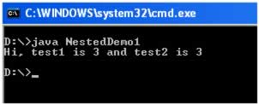
else
{
/*This block will be executed only if test1 is some value other than 5,4,3*/
System.out.println("Hi, test1 is some value other than 5,4,3");
}
}
}
else if(test1==3)
{
//This block will be executed only if "test1" is 3
if(test2==3)
{
/*This block will be executed only if test1 is equal to 3 and test2 is equal to 3 */
System.out.println("Hi, test1 is 3 and test2 is 3");
}
else if(test2==2)
{
/*This block will be executed only if test1 is equal to 3 and test2 is equal to 2 */
System.out.println("Hi, test1 is 3 and test2 is 2");
}
}

Slide 13
Java Switch Statement
The Java switch statement executes one statement from multiple conditions. It is like if-else-if ladder statement.
It is alternative to else-if ladder.
Switch Case Syntax is similar to – C/C++ Switch.
Switch allows you to choose a block of statements to run from a selection of code, based on the return value of an expression.
The expression used in the switch statement must return an int, a String, or an enumerated value.

Slide 14
Syntax
switch(expression){
case value1:
//code to be executed;
break; //optional
case value2:
//code to be executed;
break; //optional
......
//You can have any number of case statements.
default:
code to be executed if all cases are not matched;
}

Slide 15
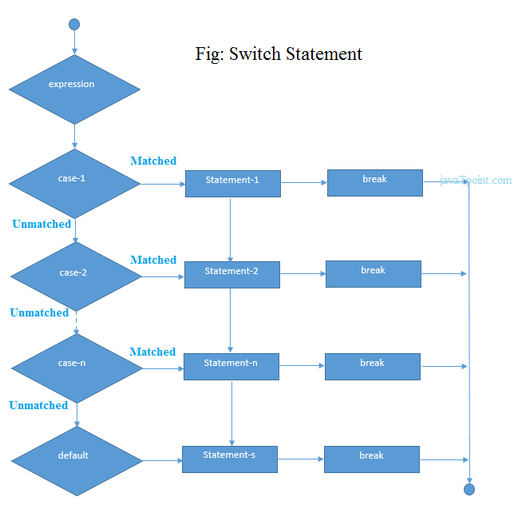

Slide 16
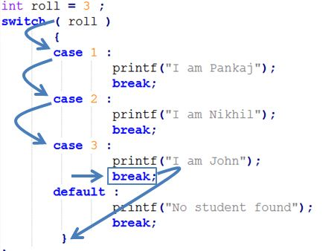

Slide 17
Example for switch
public class SwitchExample
{
public static void main(String[] args)
{
int number=20;
switch(number){
case 10: System.out.println("10");break;
case 20: System.out.println("20");break;
case 30: System.out.println("30");break;
default:System.out.println("Not in 10, 20 or 30");
}
}
}
Output
20

Slide 18
Rules apply to a switch statement
The variable used in a switch statement can only be a byte, short, int, or char.
You can have any number of case statements within a switch. Each case is followed by the value to be compared to and a colon.
The value for a case must be the same data type as the variable in the switch, and it must be a constant or a literal.
When the variable being switched on is equal to a case, the statements following that case will execute until a break statement is reached.
When a break statement is reached, the switch terminates, and the flow of control jumps to the next line following the switch statement.
Not every case needs to contain a break. If no break appears, the flow of control will fall through to subsequent cases until a break is reached.
A switch statement can have an optional default case, which must appear at the end of the switch. The default case can be used for performing a task when none of the cases is true. No break is needed in the default case.

Slide 19
End of Session - 3 Thank You !

